Slide 1
Entity Framework database first
Nook

Slide 2
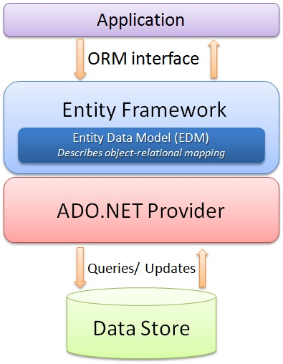
Intro
http://resource.thaicreate.com/upload/tutorial/entity-framework-introduction-01.jpg?v=1001

Slide 3
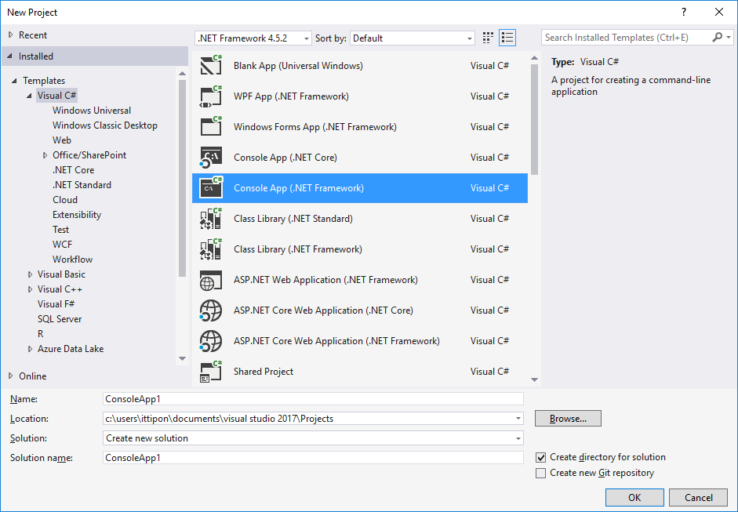
Create C# Project

Slide 4
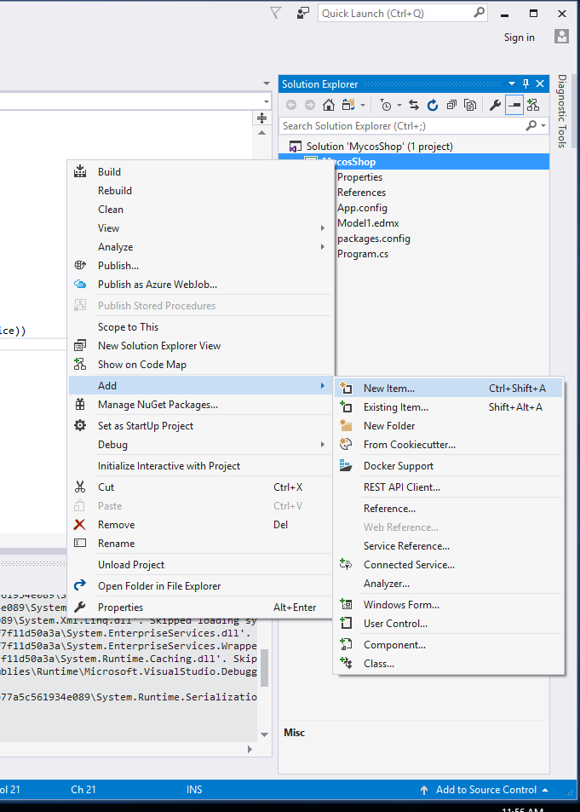
Add Entity Framework
Click Project In Solution Exploder
Choose Add then select New Item...

Slide 5
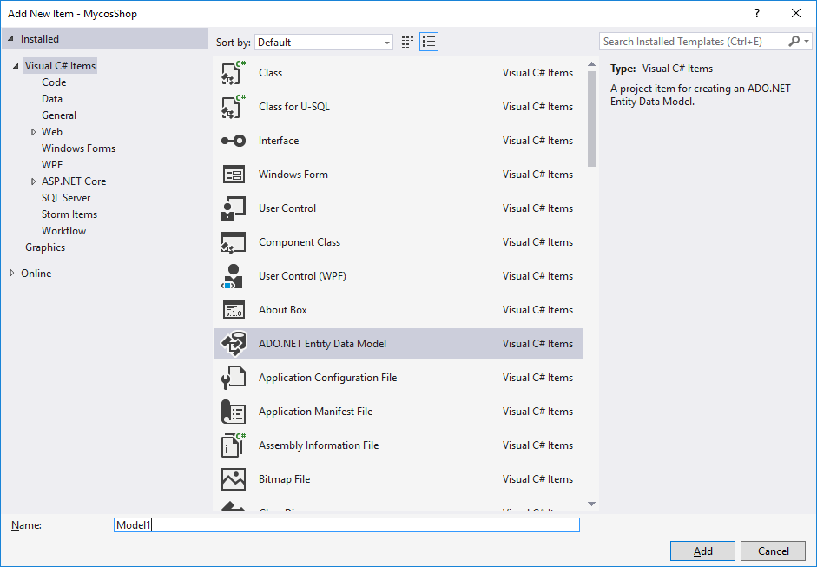
ADO. NET Entity Data Model

Slide 6
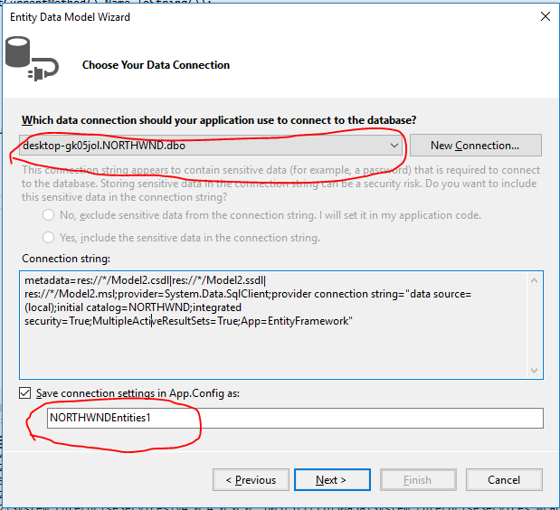
Config Connection String
Connection to Server
Name of connection to use this.

Slide 7
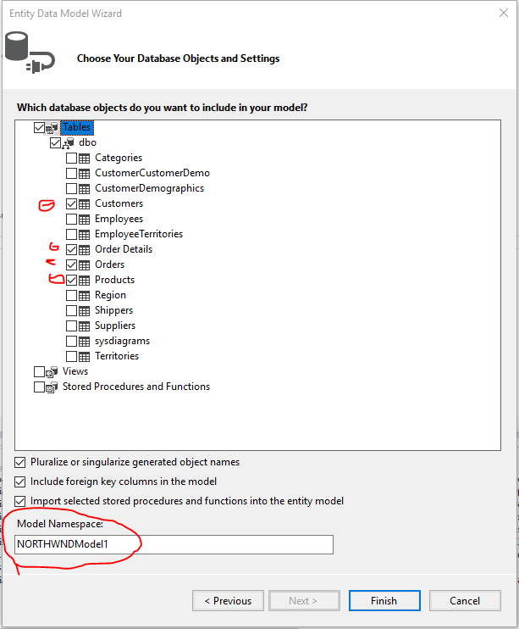
Select Tables to use.
Customers
Order Details
Orders
Products
Model Name to use this database

Slide 8
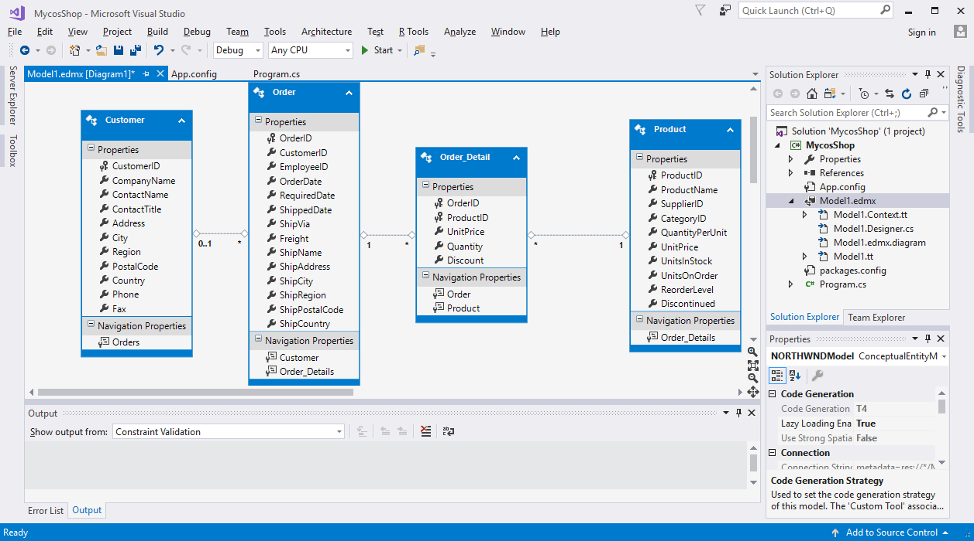
Model for database
Our classroom rules help us get along with each other:
Be respectful and responsible.
Be organized and follow directions.
Be on time.
Be prepared.

Slide 9
LINQ
Query
Lamda

Slide 10
Example
from cust in db.customers where cust.City == "London" select cust;

Slide 11
Lambda
(params) => {statements}

Slide 12
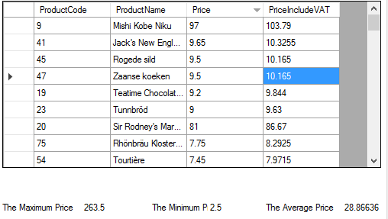
Assignment
Using NORTWIND Database to query.
In this assignment query from Product table.
1.) What LINQ ?
What LINQ ?
2) Max Price
3) Min Price
4) Average Price

Slide 13
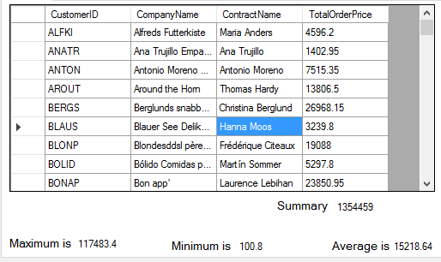
Assignment
Using NORTWIND Database to query.
In this assignment query from Product table and relate table.
1.) What LINQ ?
(TotalOrderPrice = Quantity * UnitPrice)
What LINQ ?
2) Max TotalOrderPrice
3) Min TotalOrderPrice
4) Average TotalOrderPrice
5) Sum TotalOrderPrice

